Slide 1
Part 1
Text Generation

Slide 2
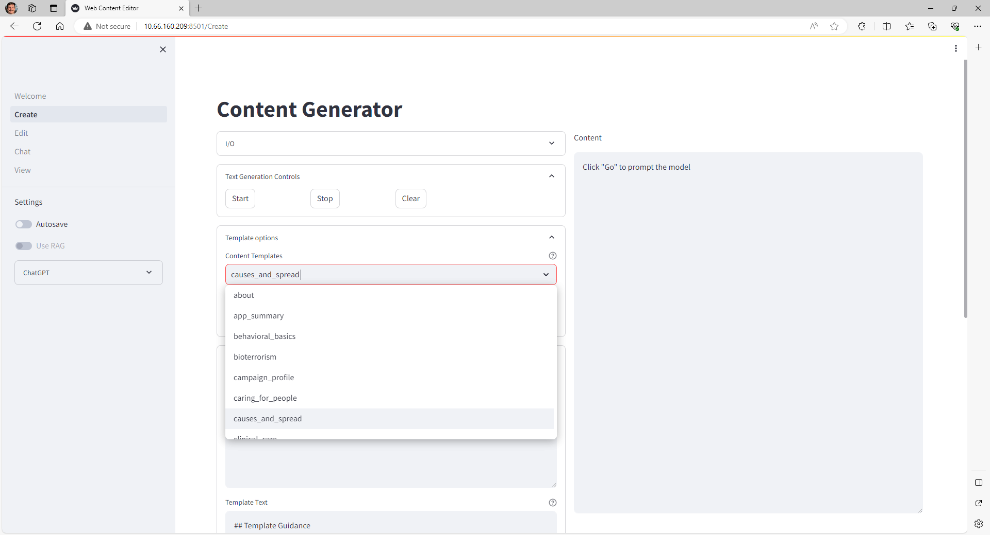
User selects content template from list.

Slide 3
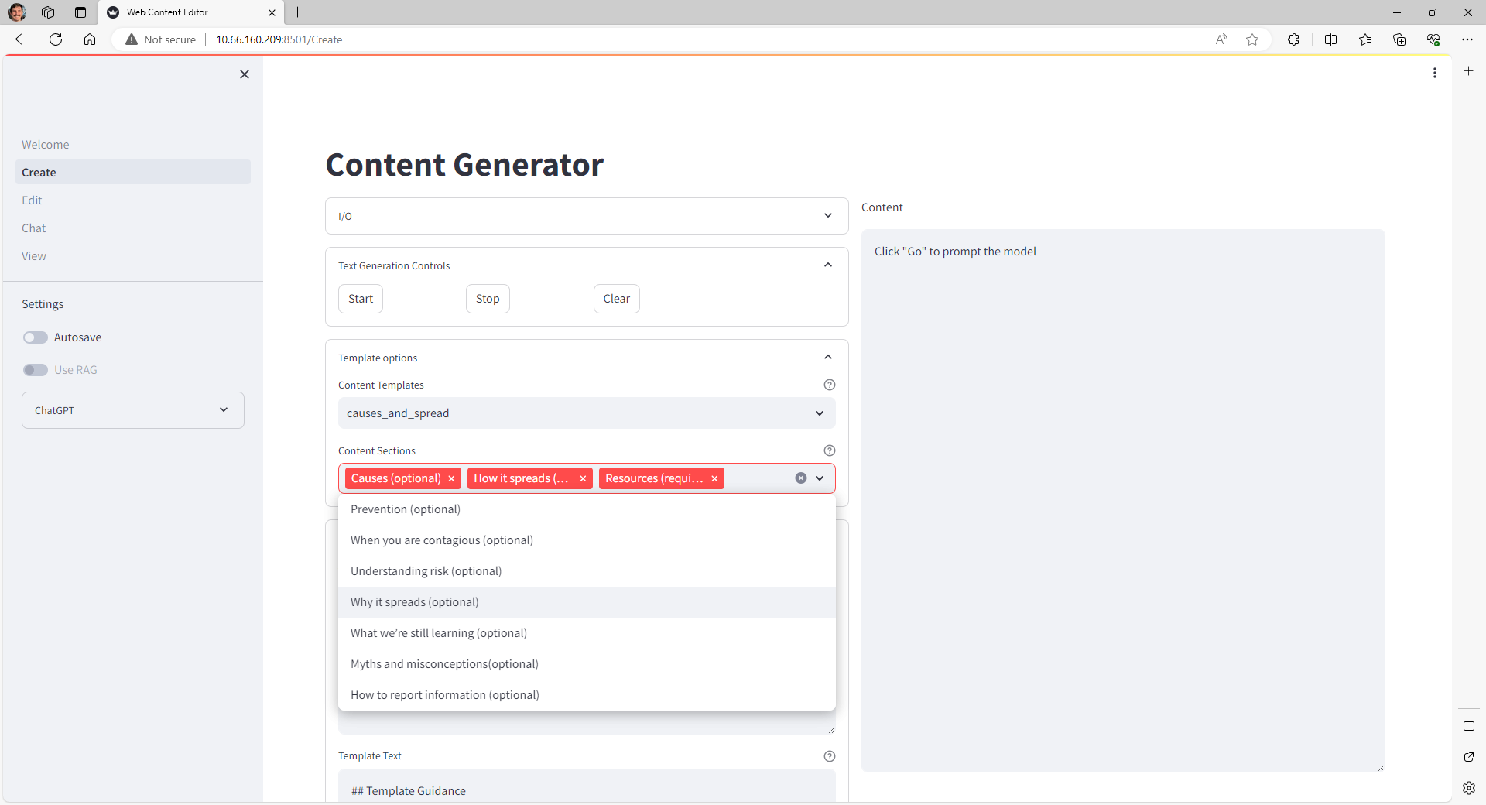
User selects which sections of the template they want to keep.

Slide 4
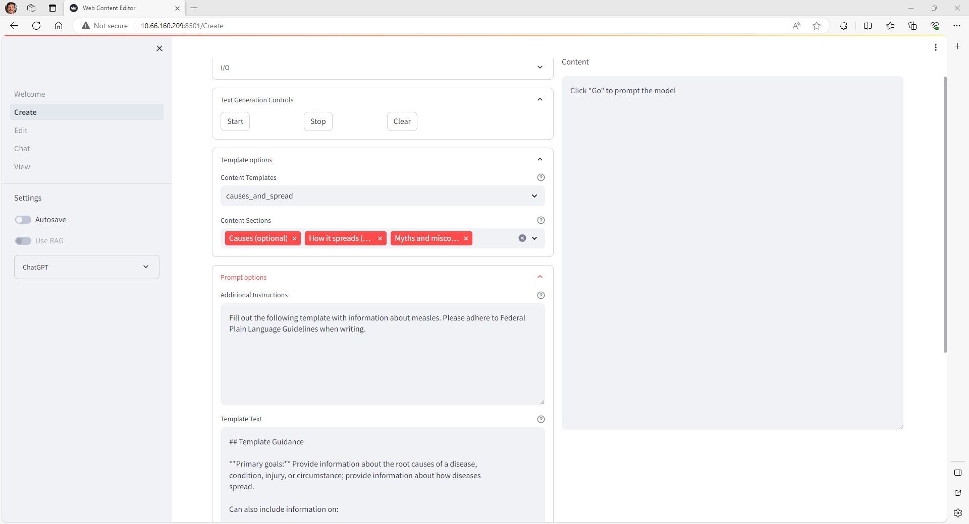
User adds instructions for the model, to include a description of the desired content.

Slide 5
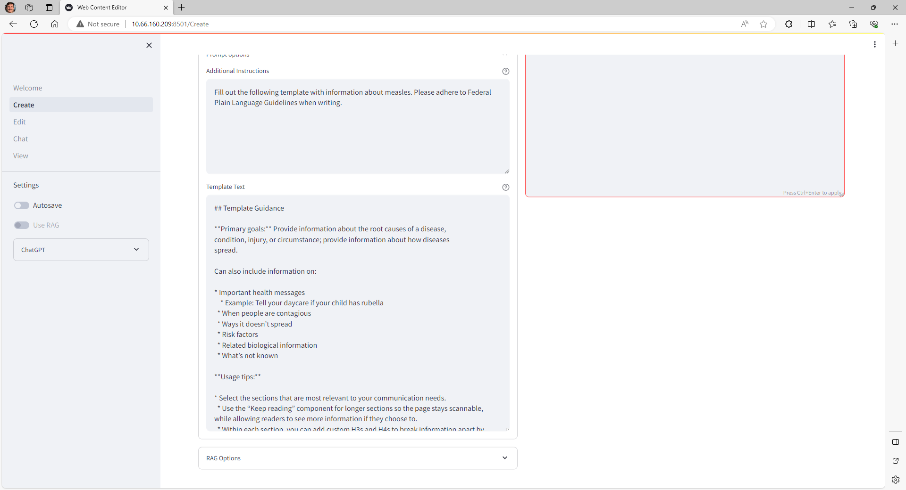
Template auto-populates with chosen sections and corresponding instructions.

Slide 6
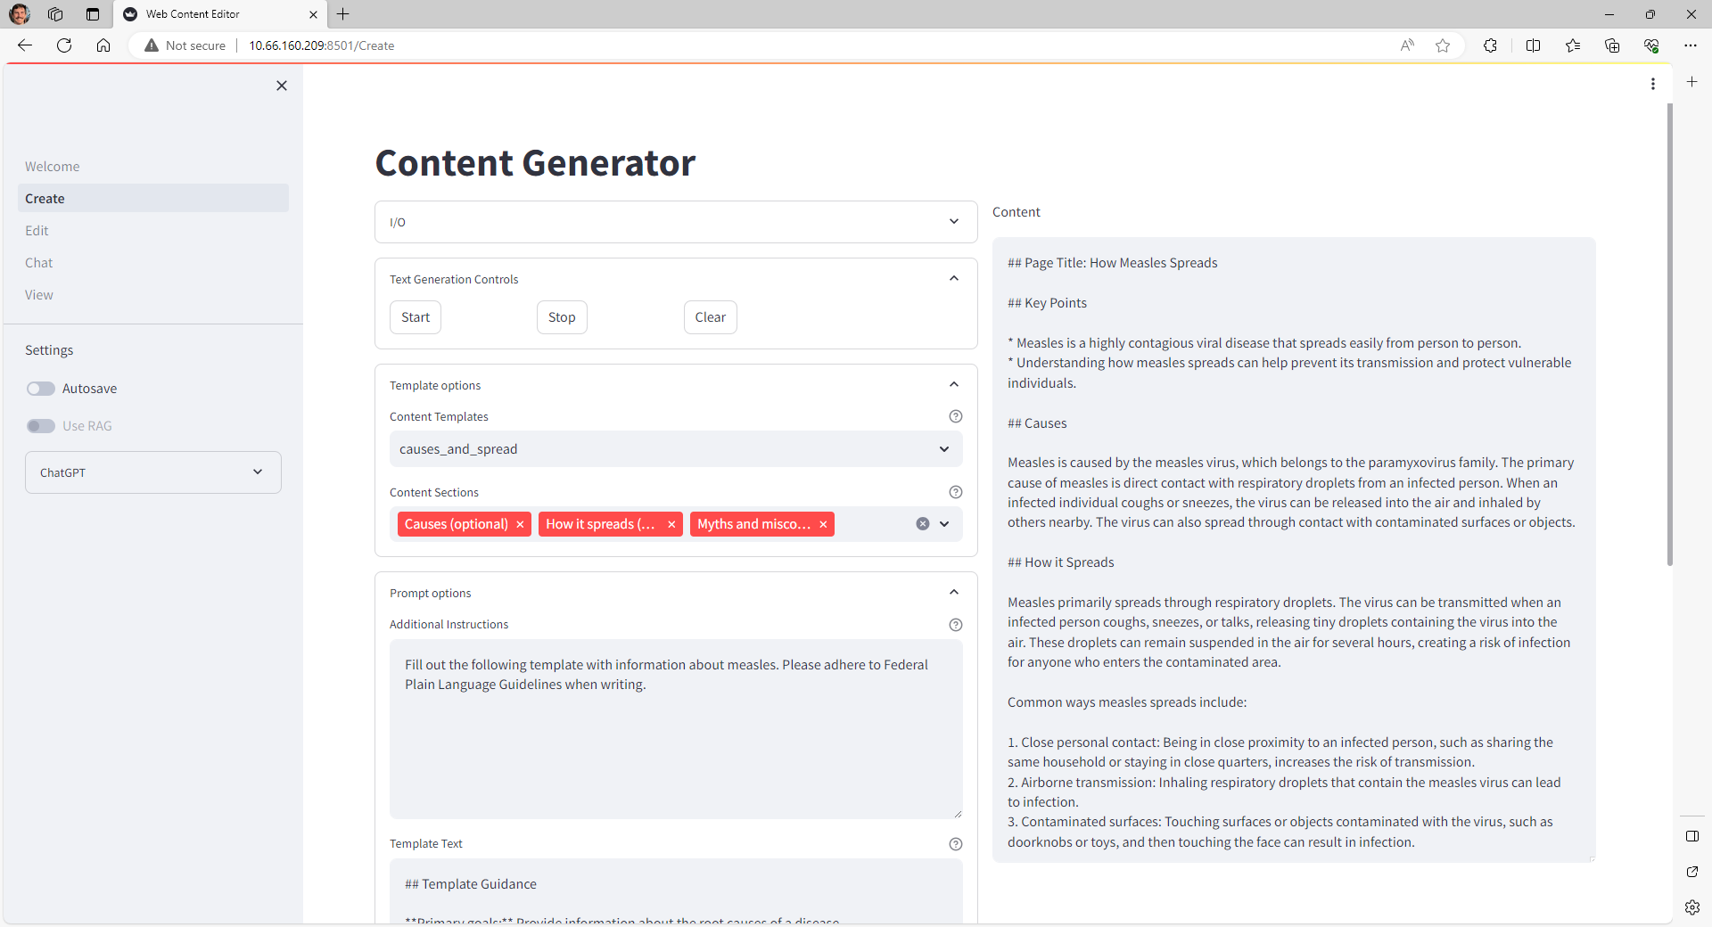
ChatGPT fills in template with
content.

Slide 7
Part 2
Reviewing and Editing

Slide 8
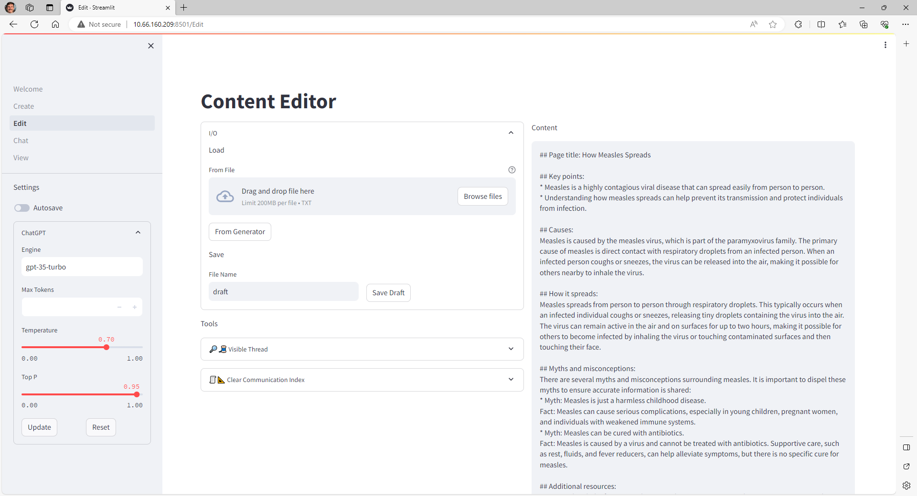
Content can be loaded from the generator page or from an existing file.

Slide 9
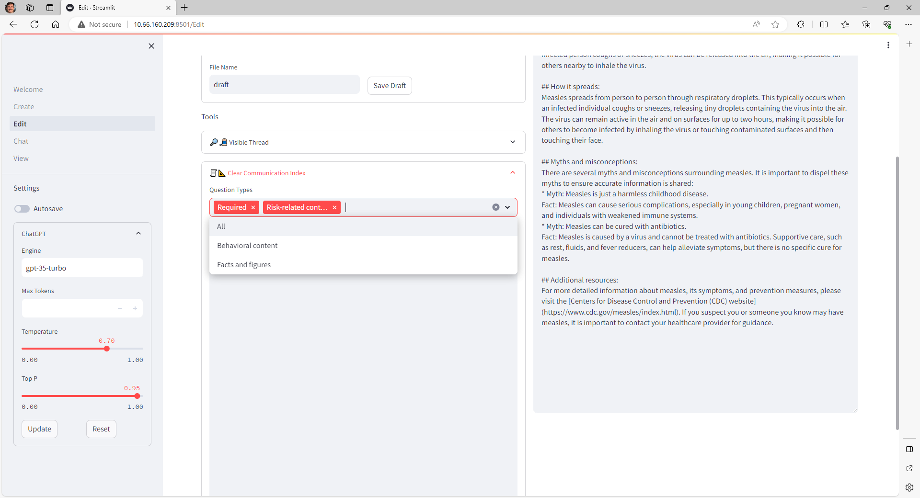
CCI tool lets users score their current draft according to the corresponding rubric.

Slide 10
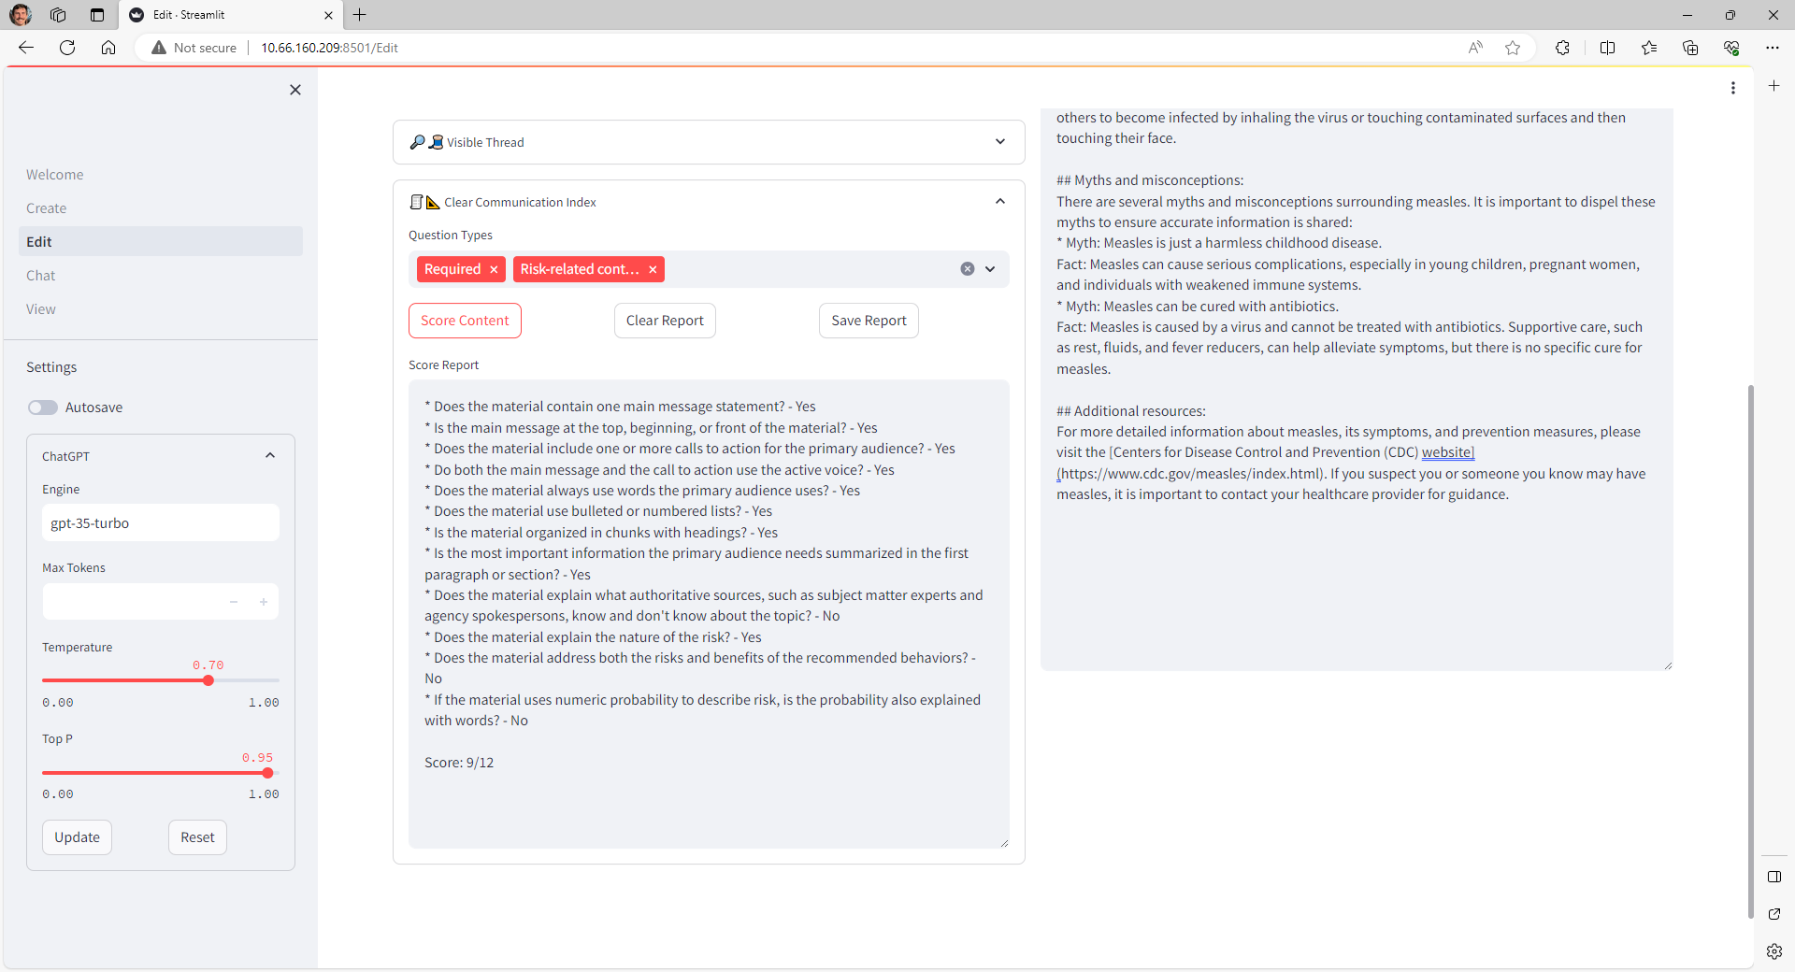
The model answers the main questions and provides a total score.

Slide 11
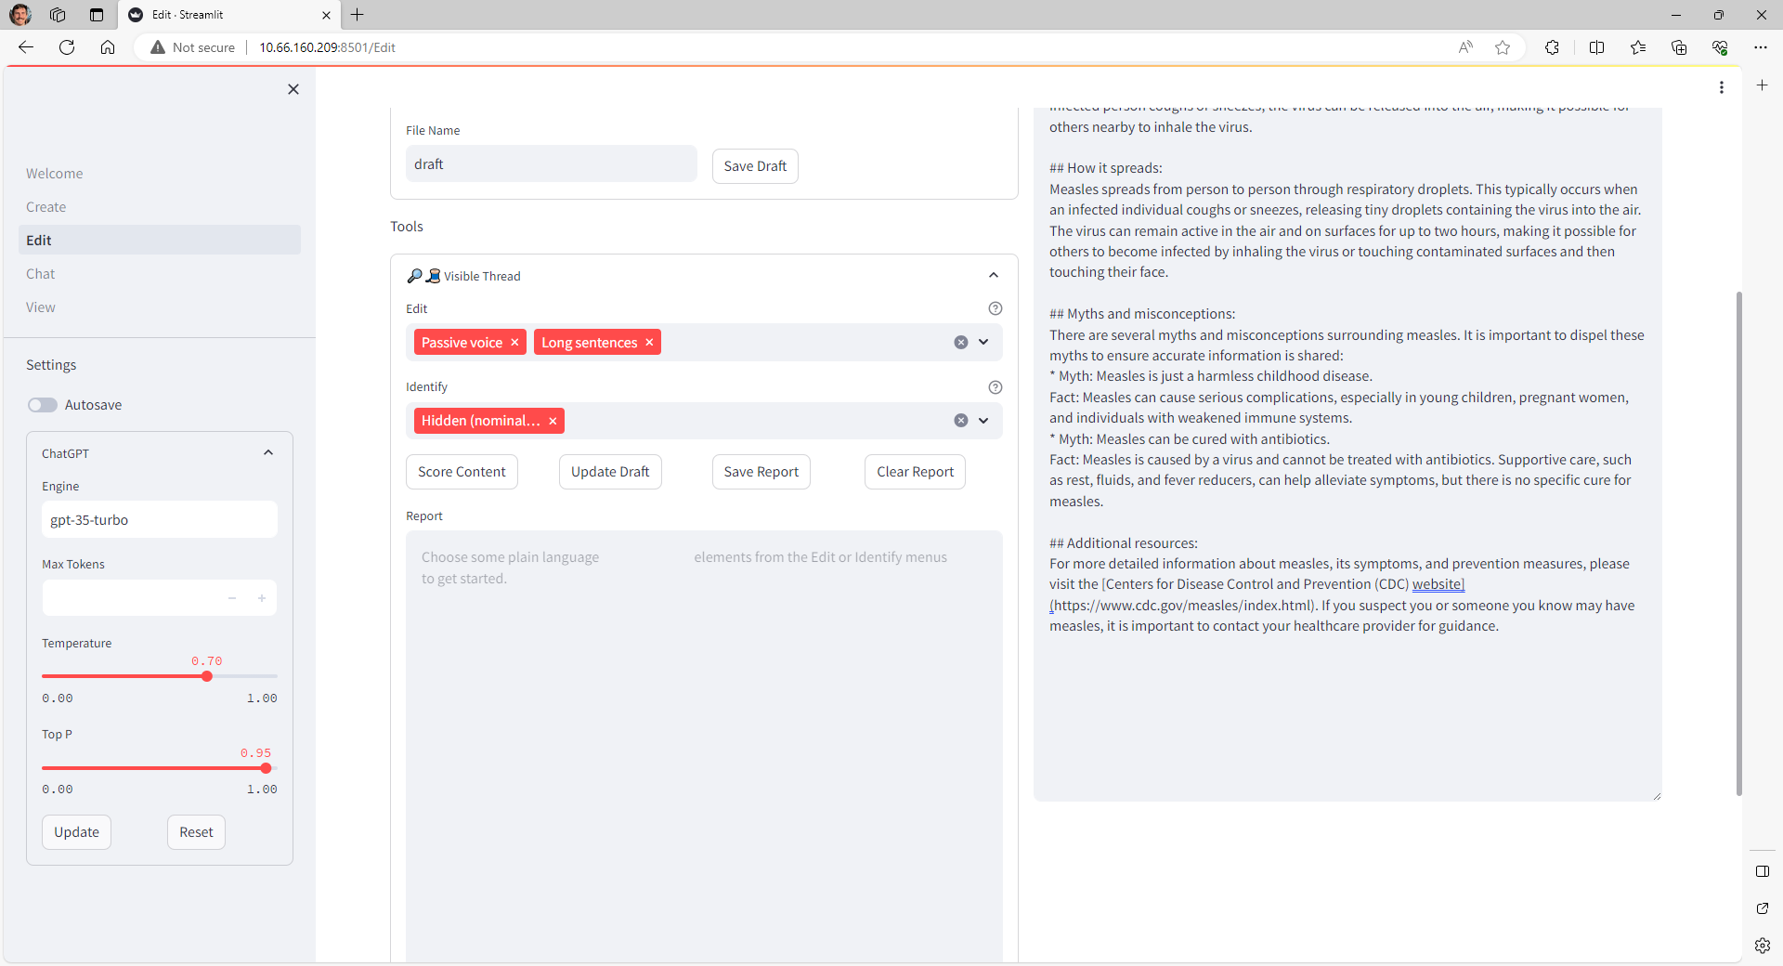
A VisibleThread-like tool lets users check and edit their content for adherence to plain language guidelines.

Slide 12
Part 3
Chat

Slide 13
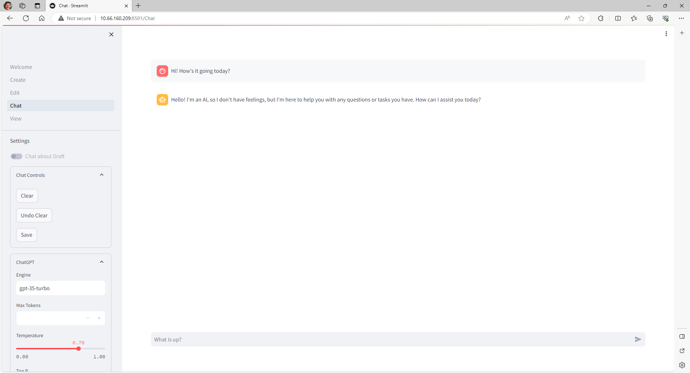
The app also has a chat feature that
lets users interact directly with ChatGPT.

Slide 14
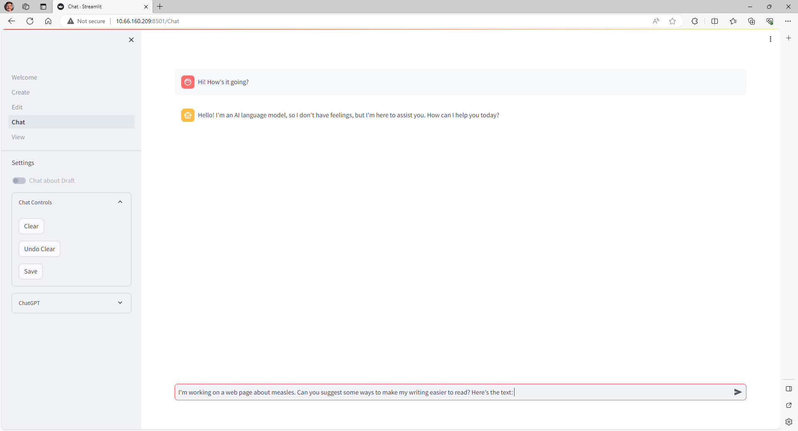
Users can paste a current draft in and ask questions about the content or toggle the “Chat about Draft” feature on, which does it for them.

Slide 15
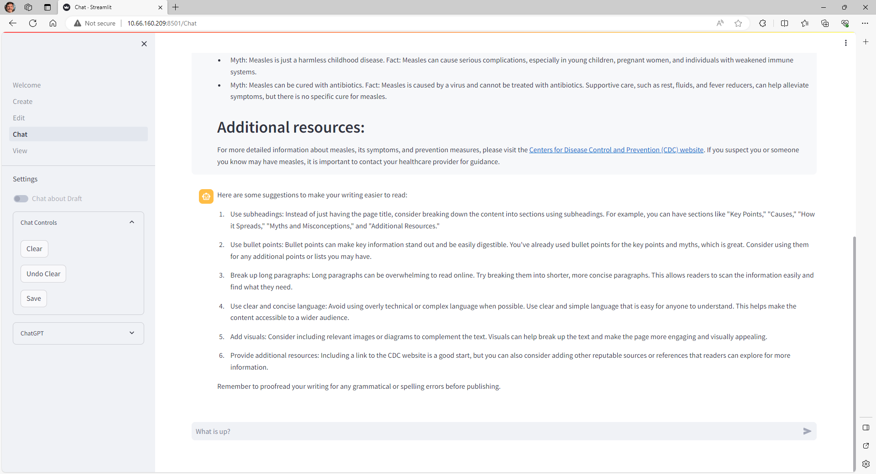
ChatGPT reads the text and then provides some suggestions for improvement.

Slide 16
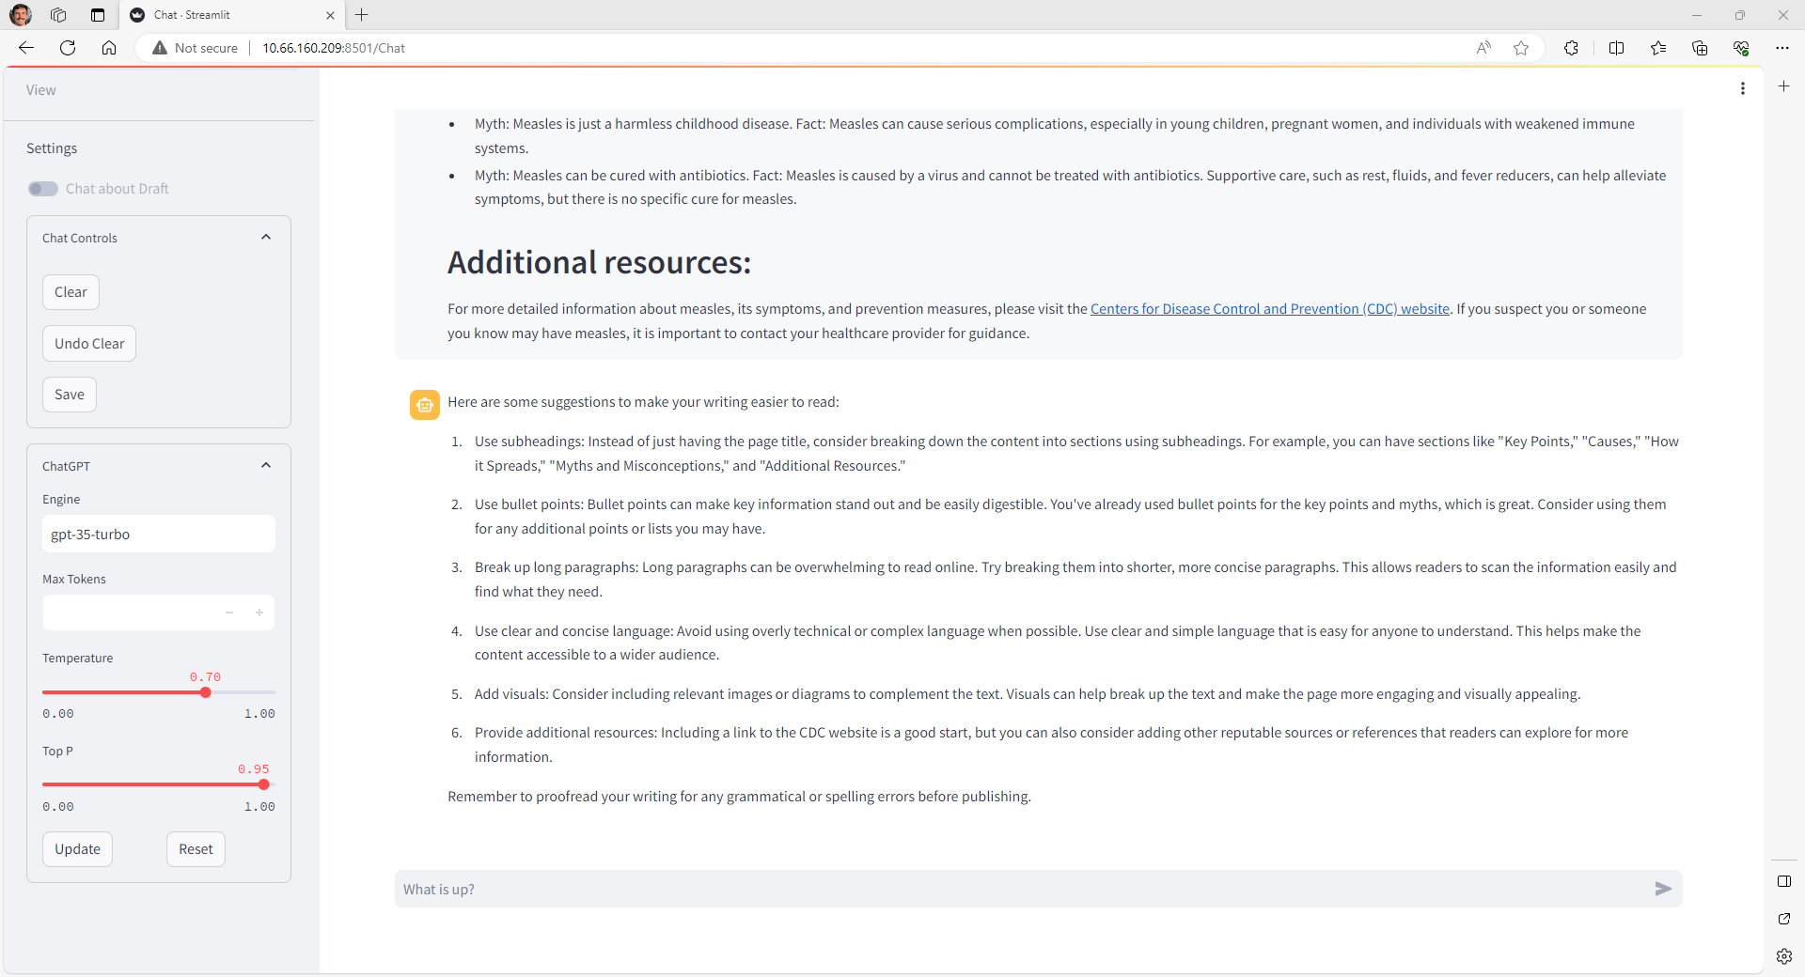


Chats can be saved, and users can change the model’s parameters to create different results.

